Slide 1
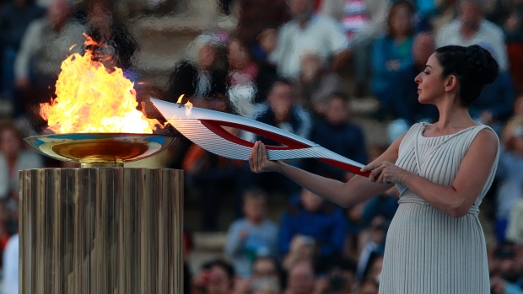

Slide 2
Initial discussion questions:
1 ) What are the Olympic Games?
2 ) Do you envy Olympic athletes?
3) What are the values of Olympism?
Olympism : What does it mean?

Slide 4
The 2016 Summer Olympics will take place from
August 5 to August 21, 2016 in Rio de Janeiro.
Brainstorm:
What do you know about the Olympic Games?
Every students should try to say a different word relating to the subject.

Slide 5
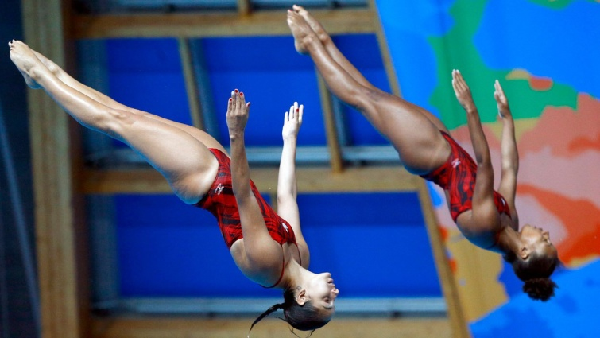
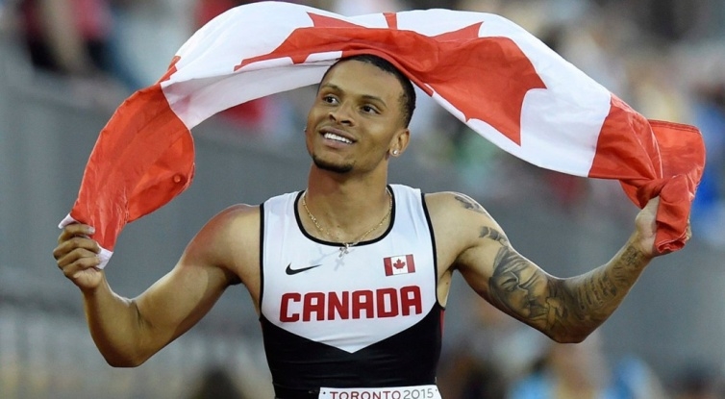
Map of medals : Winter Olympics versus Summer Olympics http://2010games.nytimes.com/medals/map.html
A map of the summer Olympics in Bejiing (2008)
http://www.nytimes.com/interactive/2008/08/04/sports/olympics/20080804_MEDALCOUNT_MAP.html

Slide 6
Opening ceremonies:
London 2012 opening ceremonies: (6:00)
http://www.youtube.com/watch?v=1AS-dCdYZbo
Los Angeles opening ceremonies Highlights: (1:37)
http://www.youtube.com/watch?v=QcWF96wSjGM
Vancouver opening ceremonies (end of film Torch)(3:39-4:41)
http://www.youtube.com/watch?v=0LZz5YQr-pg

Slide 7
The Rio 2016 WebQuest
http://webquestrio2016.weebly.com/
Your task is to collect information about various subjects pertaining to this important event.
Click on the pages History - Rio - The Torch -The Mascots to find your questions and answers.
You need a worksheet or a notebook to write down your answers.

Slide 8
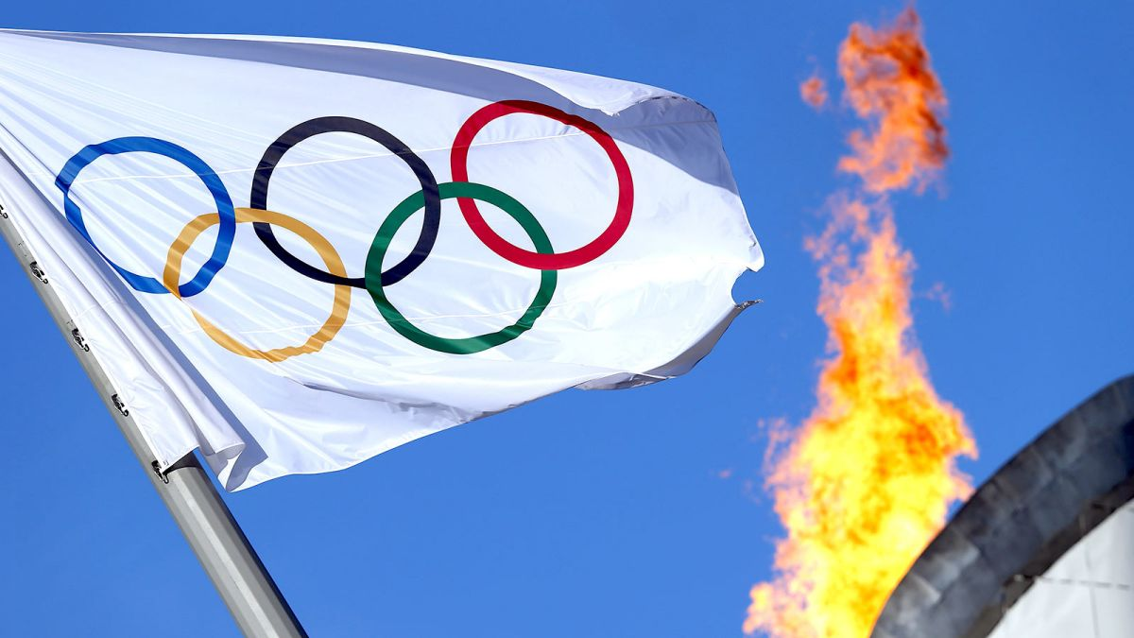
Post-Activity:
Students can prepare an exhibition or a Gallery-Tour presentation, a Powtoon, a slideshow about countries , flags and athletes, a game, a quiz, etc. Students can also take their own selfie with a mascot.
Suggested topics:
Paralympics, the city of Rio and its attractions, the design of the torch , security, budget, cheating, doping, environmental issues, amateur versus professional athletes, politics , logos and symbols, clothing, etc..
Notes:
Project

